Slide 1
iDEAtION Gold Badge Assessment – Progress updates
Insert your Ideation ID & Project name

Slide 2
Core Team Members (Brief Description of academic and business background of core team members)
CEO: Name
Background, Experience
Team member:
Name
Background, Experience

Slide 3
Project Summary
Original plan
Current achievement
Product Overview
MelanoDetect AI is an advanced, handheld AI-based skin cancer detection device with an integrated smartphone application
Target Customers
Our target customers are dermatologists and healthcare providers.
Problem Solving
Early and accurate melanoma detection.
Reducing the risk of misdiagnosis.
Ensuring timely intervention to improve patient outcomes.
Developed Innovative Technology
Developed MelanoDetect AI, an advanced handheld AI-based skin cancer detection device with a smartphone application (integration in progress).
Target Customers
Received positive responses from healthcare professionals and high usability ratings.
Problem Solving
Helps reduce misdiagnosis and supports timely treatment.

Slide 4
Business Development
Original plan
achievement
From programme start until now
Business Development Plan | Conduct interviews with dermatologists and healthcare providers to gather feedback on MelanoDetectAI usability and features Collaborate with leading dermatology departments for market research and validation studies. Continue to build strategic partnerships with healthcare providers. Attend additional industry conferences and events to increase brand awareness and gather market intelligence Launch MelanoDetect AI app on iOS and Android platforms. Participate in international trade shows and exhibitions to showcase our product to global market.
Conducted surveys with dermatologists and healthcare providers to gather feedback on the MelanoDetectAI usability and features Focus areas included high diagnostic accuracy, ease of use, potential impact of MelanoDetectAI, and current diagnostic methods Reached out to healthcare professionals through social media platforms and personal networks to share our survey questionnaire. Survey form: https://forms.gle/MjUBqSDdA9i4j4SG6

Slide 5
Technology Development
Original plan
achievement
From programme start until now
Technology Development Plan | Advance the capabilities of AI algorithms for skin lesion and melanoma detection. Conduct further R&D to optimize the performance of the MelanoDetect AI device. Implement additional features and functionalities to meet the evolving needs of dermatologists. Plan for future updates and developments to ensure MelanoDetectAI remains at the forefront of skin cancer detection technology.
Integrated DenseNet-201, EfficientNet-B2, ResNet-50, and VGG-19 models for skin lesion and melanoma detection. Optimized AI algorithms for enhanced accuracy in melanoma detection. Evaluated models using the HAM10000 dataset. Developed a prototype of the handheld device hardware for initial testing. Designed the basic UI/UX for app Implemented features in the app to capture or upload images for classification as benign or malignant. Conducted internal testing and debugging of the app and handheld device prototype to ensure functionality and reliability.
*A workable prototype expected to be launched by the end of the programme.

Slide 6
Corporate Development
Original plan
achievement
From programme start until now
Financial Plan | Ensure financial stability and explore funding options. Continue financial audits and optimizations to improve cost-efficiency and resource management. Monitor subscription pricing and revenue model based on market feedback and performance. Secure additional funding and investment as needed for scaling operations and product development.
Others (Awards, IP, etc)
Maintained financial stability by effectively managing resources and optimizing costs during the early development phase. Finalized the subscription pricing based on market research and feedback from target customers

Slide 7
Part 2
Market Validation Report

Slide 8
Market Validation Report
Market Validation Report will be part of Gold Badge Assessment.
Market validation is the process of presenting a concept for a product to its target market and learn from those prospective buyers whether or not the idea is worth pursuing.
Complete a process of Market Validation for your products can allows you to:
Clearly identifies customer needs
Defines your prototype requirements
Common approaches to market validation are:
Interview people in your targeted market, such as your target customers and potential partners
Send out surveys
Host focus groups

Slide 9
Who are your target customers and Why?
Target Customers:
Our target customers are dermatologists, healthcare providers, and clinics specializing in dermatology and oncology.
- Expert Use Case Alignment
Dermatologists and healthcare providers are at the forefront of skin cancer diagnosis and treatment which makes them the primary users of diagnostic tools like MelanoDetectAI.
- Critical Need for Precision
These professionals require accurate and reliable tools to ensure early and precise melanoma detection, reducing misdiagnosis and improving patient outcomes.
- Enhanced Workflow Efficiency
MelanoDetectAI supports clinicians by integrating seamlessly into their practice. It offers real-time results that save time and enhance decision-making.

Slide 10
Feedback from Target Customers
We gathered feedback from healthcare professionals via structured survey
Survey Distribution
- Conducted surveys among healthcare professionals within our social circle.
- Used social media platforms to reach out to healthcare professionals.
Methods Used
Structured questionnaires focused on healthcare professionals' perspectives regarding usability, features, and potential impact of MelanoDetectAI. It also gathered insights into challenges with current diagnostic methods for melanoma.

Slide 11
Feedback from Healthcare Professionals
We gathered feedback from healthcare professionals via a structured survey
MelanoDetectAi’s Additional Features or Functionalities Desired
“To be accessible in an affordable range”
- General Practitioner
“Diagnosis specificity and sensitivity”
- House officer
Features of an AI-Based App Most Prioritized
“High diagnostic accuracy, Ease of use, Affordable price”
- General Practitioner
“Ease of use, Portability, Integration with existing clinical systems”
- Dermatologist

Slide 12
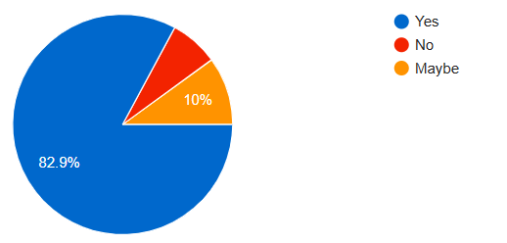
Data Analysis
1- Interest in MelanoDetectAI
Around 83% of respondents are willing to adopt a handheld AI device for early skin cancer detection and 10% expressed conditional interest ("Maybe") due to concerns about diagnostic accuracy.

Slide 13
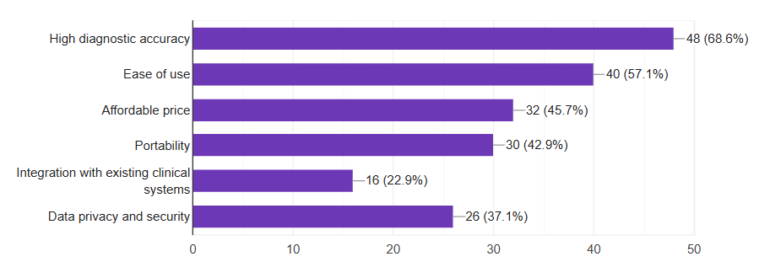
Data Analysis
2- Top Features Prioritized
The most important features identified were:
- High diagnostic accuracy (68.6%)
- Ease of use (57%)

Slide 14
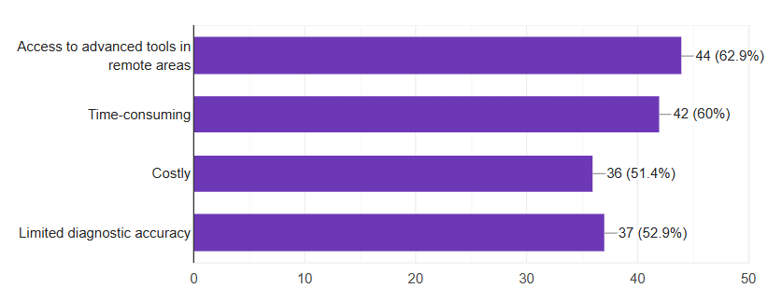
Data Analysis
3- Challenges Addressed by MelanoDetectAI
Key issues faced by healthcare professionals include:
- Limited access to advanced tools in remote areas (62.9%)
- Time Consuming (60%)

Slide 15
Refine
Survey insights highlighted ease of use and high diagnostic accuracy as top priorities. Based on this, we are refining the following:
Diagnostic Accuracy and Transparency:
Enhancing algorithms with diverse datasets for improved diagnostic precision and providing clear result explanations to build user trust.
User Experience:
Simplifying the interface with visual aids and accessibility features.
Health Professional Integration:
Adding advanced reporting tools and EHR compatibility for seamless use in clinical settings.

Slide 16
Timeline
ACTIVITY | Months 1-3 | Months 4-6 | Months 7-9 | Months 9-10 | Months 11-12 | Month 12
Algorithm Development and Selection | ✔
Integration with Handheld Device and App Development |  | ✔
Eco-friendly Prototyping and Development of MelanoDetect AI Device |  |  | ✔
Real-Time Analysis and Reporting Features integration |  |  |  | ✔
User Experience Enhancement and Agile Development |  |  |  |  | ✔
Global Collaboration and Market Expansion |  |  |  |  |  | ✔

Slide 17
Resources
Technical Resources
Advanced computing hardware for AI model optimization and testing.
Reliable cloud infrastructure for secure data storage and app integration.
Human Resources
Mobile app developers to finalize the smartphone application integration.
Medical advisors to ensure clinical accuracy and compliance.
Data Resources
Access to diverse, high-quality datasets for melanoma and benign lesions.
Collaboration with dermatology clinics for data validation and testing.
Deployment
Preparing for Play Store and App Store launches.

Slide 18
Success Metrics
Technical Performance
AI model achieves over 95% accuracy in detecting melanoma vs. benign lesions.
Real-time results delivered within seconds.
User Adoption
Positive feedback from healthcare professionals during clinical testing.
Successful on boarding of 50+ early adopters within the first six months.
Regulatory Compliance
Approval for clinical use in local healthcare facilities.
Market Readiness
Integration of the app with the prototype device.
Launch on Play Store and App Store with 10,000+ downloads in the first quarter.
Impact on Healthcare
Reduced misdiagnosis rates in early clinical trials.

Slide 19
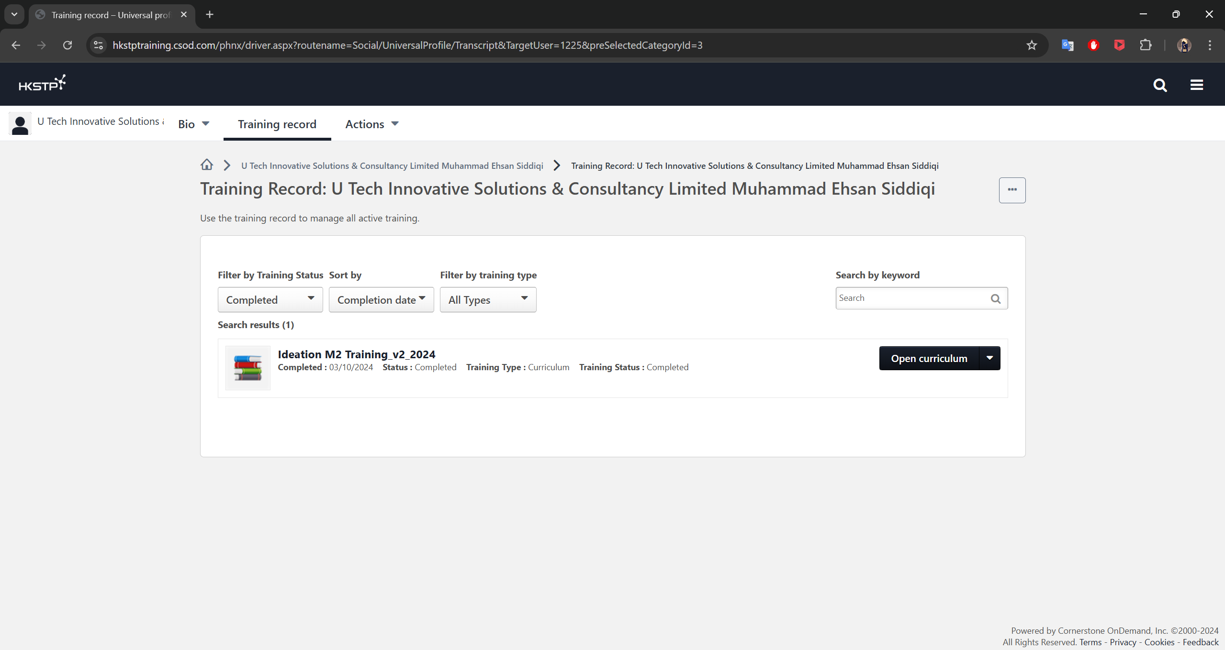
Proof of Training Completion

Slide 20
Innovation Type
According to the training “4 Innovation Type”, the innovation type of MelanoDetectAI is Technology Innovations.
Technology Innovations
MelanoDetectAI uses advanced deep-learning algorithms for melanoma detection
Improves diagnostic accuracy and efficiency
Addresses existing market needs with upgraded product performance
Aims to make healthcare smarter and more efficient

Slide 21
Joined our Meetups @ HK Science Park yet?
Screen Capture on joining as the member of Meetups @ HK Science Park (https://www.meetup.com/meetups-hk-science-park/)

Slide 22
Declaration
I here declare, on my own behalf and on behalf of the Grantee of Ideation Programme, its directors, its employees/ team members that:
(Please tick “✔” the box to confirm)
The information and content provided in this report is true, accurate, complete, up-to-date and not misleading.
All Mandatory Admission Criteria of Ideation Programme is met.

